Slide 1

Coded Correspondence
Python project
Knox Maclean Bather
09/10/2023

Slide 2
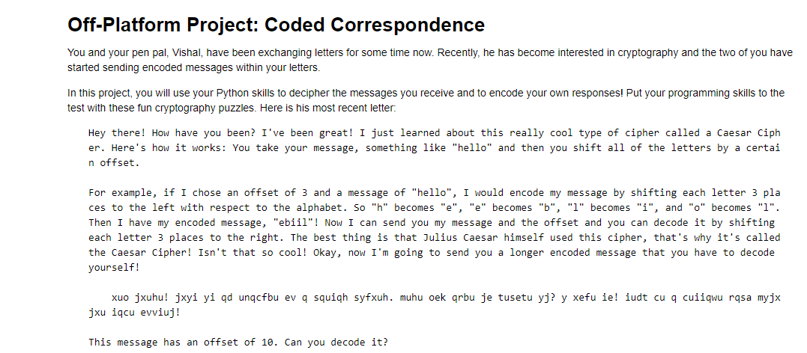
Project Explaination

Slide 3
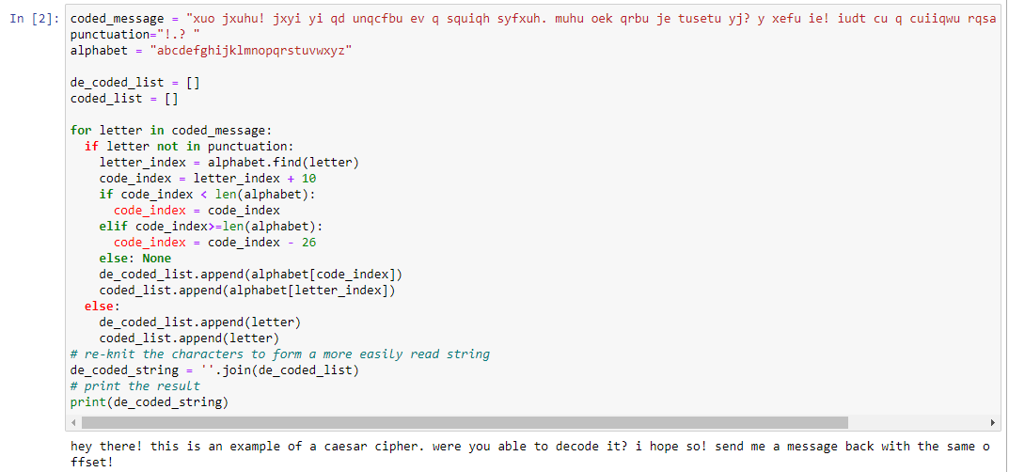
1. De-code Vishal’s message.
Set up
I used embedded loops (for and if/elif) to de-code the message.
I noted down all the non-letter characters (including spaces) in a ‘punctuation’ list and created a separate alphabet list. This allowed me to cycle through the index values of individual letters in order, while keeping them separate from the additional characters.
I made use of a for loop to cycle through the elements of the coded message.
Using a series of if/elif/else clauses and the .find() method I identified the index of the letters within the alphabet list and offset that value by the code value (in this case +10), making sure to cycle the value back to the start if it went out side of the length of the alphabet list.
Main code
Result

Slide 4
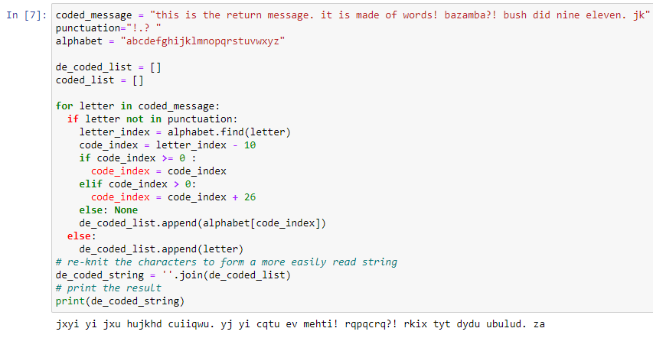
2. Encode your own message to send back to Vishal.
I used embedded loops (for and if/elif) to re-code my own message using the same Caeser cypher character offset. The method is the same except for reversing the offset.
I created a list for all the punctuation and a list for all the alphabetical characters.
I made use of a for loop to cycle through the elements of the coded message.
Using a series of if/elif/else clauses and the .find() method I identified the index of the letters within the alphabet list and offset that value by the code value (in this case -10), making sure to cycle the value back to the start if it went outside of the length of the alphabet list. The lower boundary ( < 0 ) was the one to account for in this iteration of the code.
Set up
Main code
Result

Slide 5
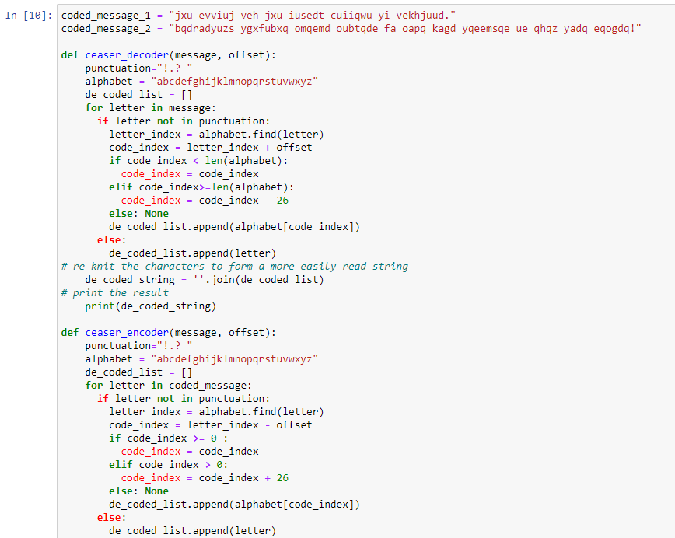
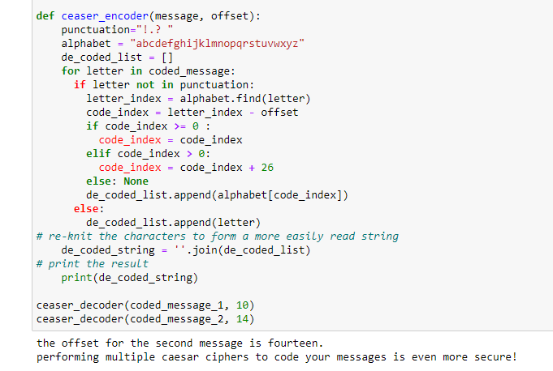
3. De-code two messages and create a function for coding and decoding messages.
En-coding function
De-coding function
Created two function for the de/en-coding of messages using the Caeser cypher. The variables of the functions were the string message and the offset of encryption.

Slide 6
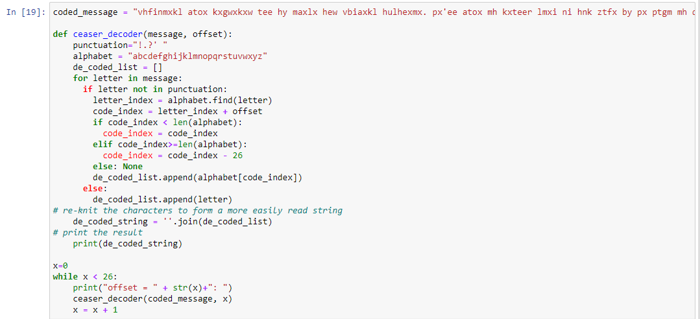
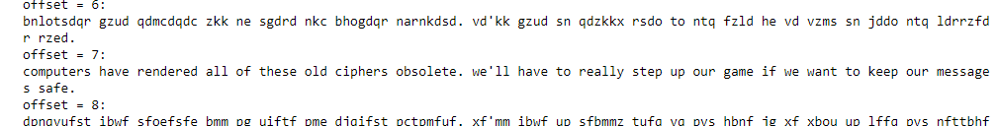
4. Solving a Caeser cypher without knowing the offset.
Using the same code and function as previous questions, I iterated through all possible offsets (0-25) to brute force the cypher solution. After inspection of the results, it was clear that the offset of this message was 7.
I chose this method due to the low number of possible offsets. This makes the solution much easier to find and I therefore deemed it a more efficient method to obtaining the desired result.
Result

Slide 7
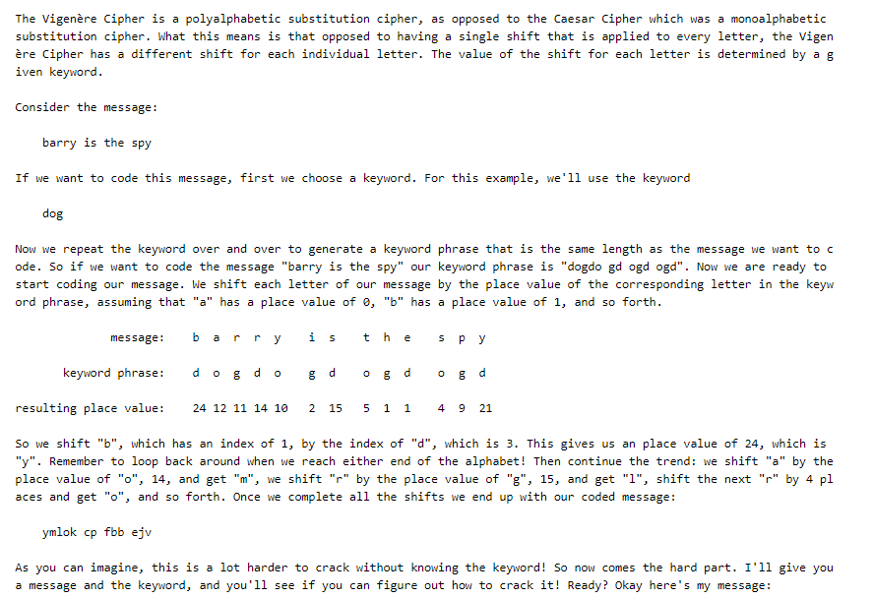
5. The Vigenere Chipher

Slide 8
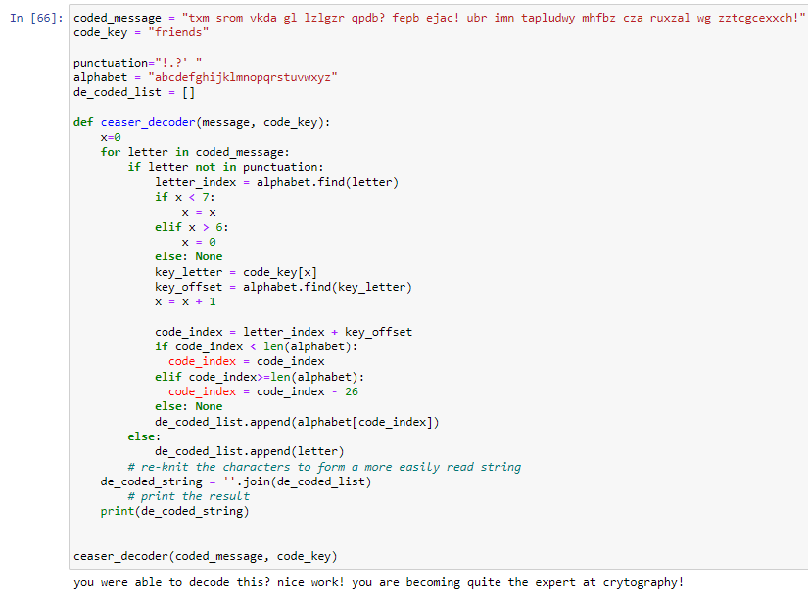
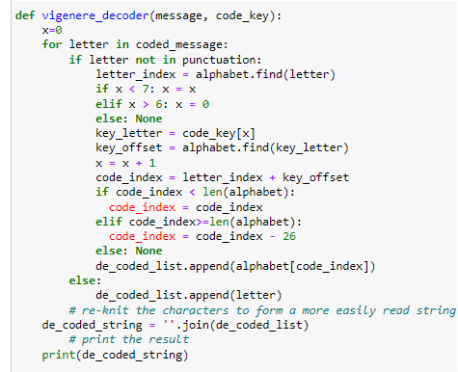
5. Solving a Vigenère Cipher message.
To iterate through the code’s key word/phrase I used a .find() method and a series of if/elif statements to return each individual letter and its numerical placement in the alphabet.
Putting this into the ‘if letter not in punctuation’ statement ensured that the code’ key word/phrase would only be associated with the letters in the coded message.
I used x<7 and x>6 towards the top of the if function as the codeword was “friends” which has seven letters. This could be improved for other code_words but using len(code_key) inplace of “7” and len(code_word)-1 in place of “6”.

Slide 9
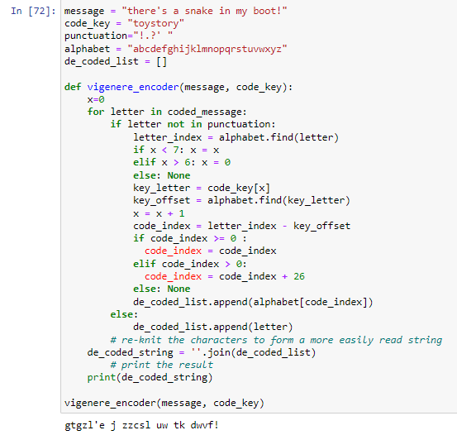
6. Encoding a message using the Vigenère Cipher.
Altering the existing code from question 5 to encode messages rather than decode them.
This includes:
- the if/elif block of code to cycle through the key code word.
- the if/elif block of code to cycle through the alphabet in reverse order.

